Slide 1
FINANCIAL INCLUSION ANALYSIS REPORT
GROUP NAME: Brainy Badgers

Slide 2
GROUP MEMBERS
1.Patrick Kiplimo
2.Brenda Chepkoech
3.Stacy Keago
4.Kevin Kilonzo
5.Brandon Bosire

Slide 3
BUSINESS OVERVIEW
Financial inclusion means that individuals and businesses have access to useful and affordable financial products and services that meet their needs – transactions, payments, savings, credit and insurance – delivered in a responsible and sustainable way.

Slide 4
Problem Statement
Financial inclusion remains one of the main obstacles to economic and human development in Africa. For example, across Kenya, Rwanda, Tanzania, and Uganda only 9.1 million adults (or 14% of adults) have access to or use a commercial bank account. In the recent past, there has been a significant growth of innovative fintech solutions like MPESA services.
Our research focuses on how mobile money transaction services(fintech and mobile banking) can lead to greater financial inclusion for people who don't have access to banks. Greater financial inclusion leads to easier transactions, greater access to credit services, an easier tax base to achieve revenues, better access to savings, insurance, and fintech services.

Slide 5
Objectives
Our main objective:
To determine the number of people who have access to mobile phones and don't have access to the banks so as to advise the fintech companies on the areas or markets that they should target.
Some of the specific objectives to be covered:
To determine the number of people with access to bank accounts and how this varies in urban and rural areas, between the job type.
To determine the country with the most mobile phones and the highest number of bank accounts.
To determine the people to be targeted with mobile banking integration
To determine the job type to be targeted with fintech marketing in the region for people with cell phones
To determine the influence of mobile phone access and location to job type a phone but no bank account
To determine the influence of mobile phone access and location to job type

Slide 6





Analysis Tools
-For our analysis, we used the Financial Inclusivity Dataset.
Libraries used: a) pandas b) numpy
2. Analysis used:
3. Visualizations used:
a)
b)

Slide 7
Analysis process
Business Understanding
Data Understanding
Data Preparation
Analysis
Recommendations
Conclusion
Problem statement and goals
Load datasets
then
view data
Data cleaning
Use tools to achieve objectives
Get insights from analysis for target marketing.

Slide 8
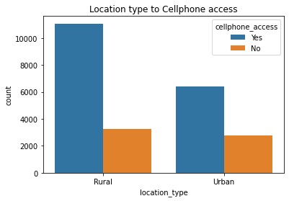
Data visualization
The graphs below show the insights to be derived from the Financial Inclusions dataset

Slide 9
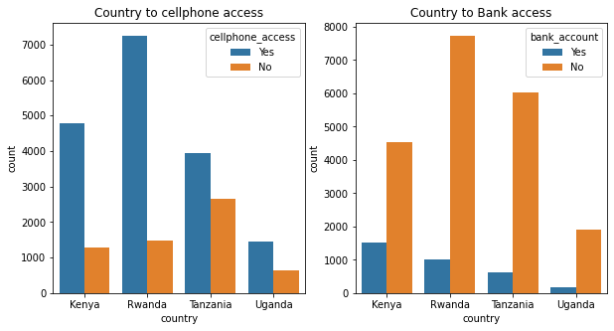

Slide 10
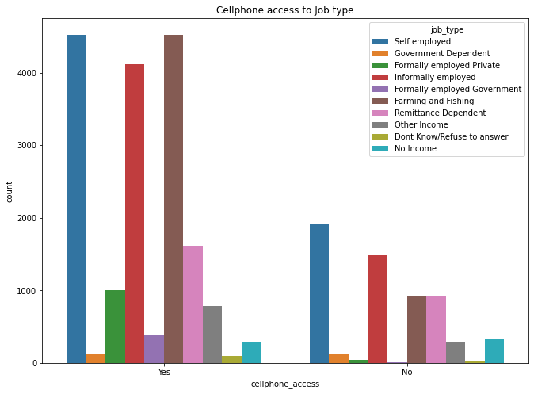

Slide 11
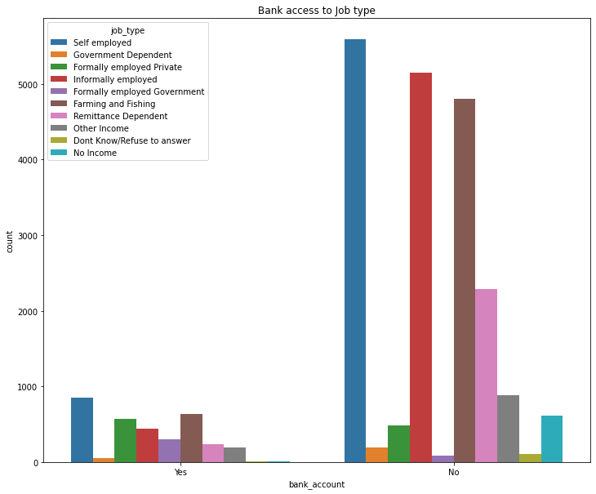

Slide 12
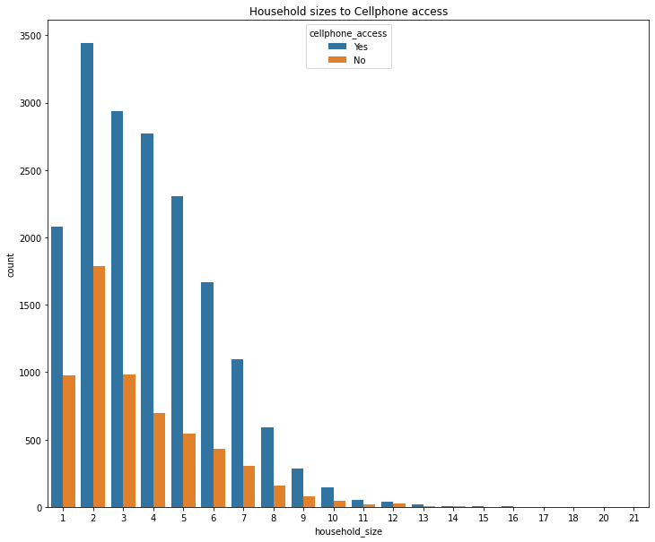

Slide 13
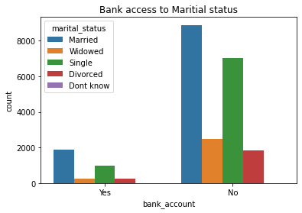

Slide 14
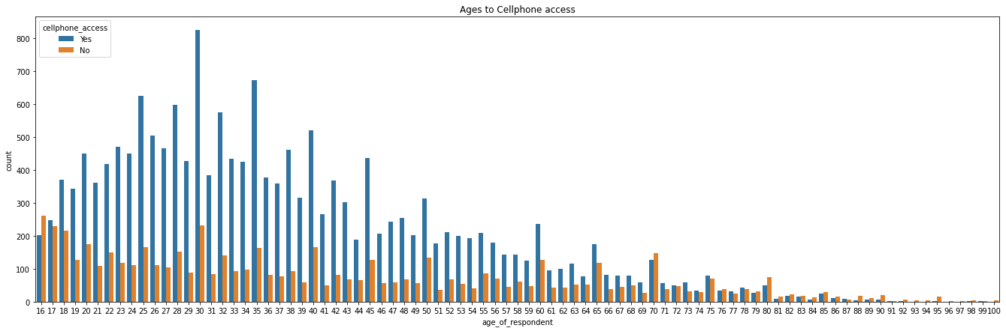

Slide 15
Research findings
During our analysis, we were able to identify, through the returned results for the following research objectives ;
There were more bank accounts in the rural areas, (1,671) than urban areas (1,641).
The self employed, farming and fishing occupations had the most bank accounts.
Kenya had the highest number of bank accounts(1,521) in the region.

Slide 16
Rwanda had the highest number of access to cellphones (7,249 respondents).
The self-employed, Farming and fishing and formally employed private had highest access to bank accounts and cellphones.
The job type Farming and fishing, self and informally employed had access to the cellphones and no access to bank accounts.
The self and the informally employed had highest access to cellphones in urban areas.
while farming and fishing and other income had highest cell phone access in rural areas.
The remittance dependent in urban areas had the lowest access to cellphones.
Age of 30 had highest access to both mobile phones bank accounts.

Slide 17
Cell phone access distribution: Rwanda 41% , Kenya 27%, Tanzania 22% and Uganda 8% of the respondents.
74% of respondents in the region had cell phone access.
14,343 respondents in rural areas and 9,181 of respondents in urban areas had access to cellphones.
Primary and secondary education had the most people to access to cellphones.
Married and single had the most access to cell phones.
Small households (1 to 5 members)had the most access to cellphones.

Slide 18
Recommendations
From our analysis, we would recommend that the fintech companies should target people in the age group of 18 to 40 as the market for their products.
The banks should target the self-employed people, farming and fishing industries for mobile banking integration as they have most people with cell phones and bank accounts.
Fintech services can also focus on offering 2 for 1 deals or party group deals to entice smaller households to take package deals
The fintech companies should focus more on rural areas because there is a bigger market that has not been tapped.

Slide 19
Conclusion
Prioritizing the recommendations above would not only increase the return on investment for fintech companies but ensure financial inclusivity across the East African region.

Slide 20
THE END
Feedback
Questions

